Slide 1

Uses and Tools/Techniques used in Databases
Henry Tabiri Adjei
Level 2 Extended Certificate In ICT

Slide 2


Introduction to databases
What is a Database.
A database is an organized collection of structured information or data, this data can be stored and manipulated at any point in time.
Why do we use Database?
We use Database to manage large amounts of Data.
To Build an organized structure which improves productivity.
To keep information safe
Database helps people to work collaboratively

Slide 3
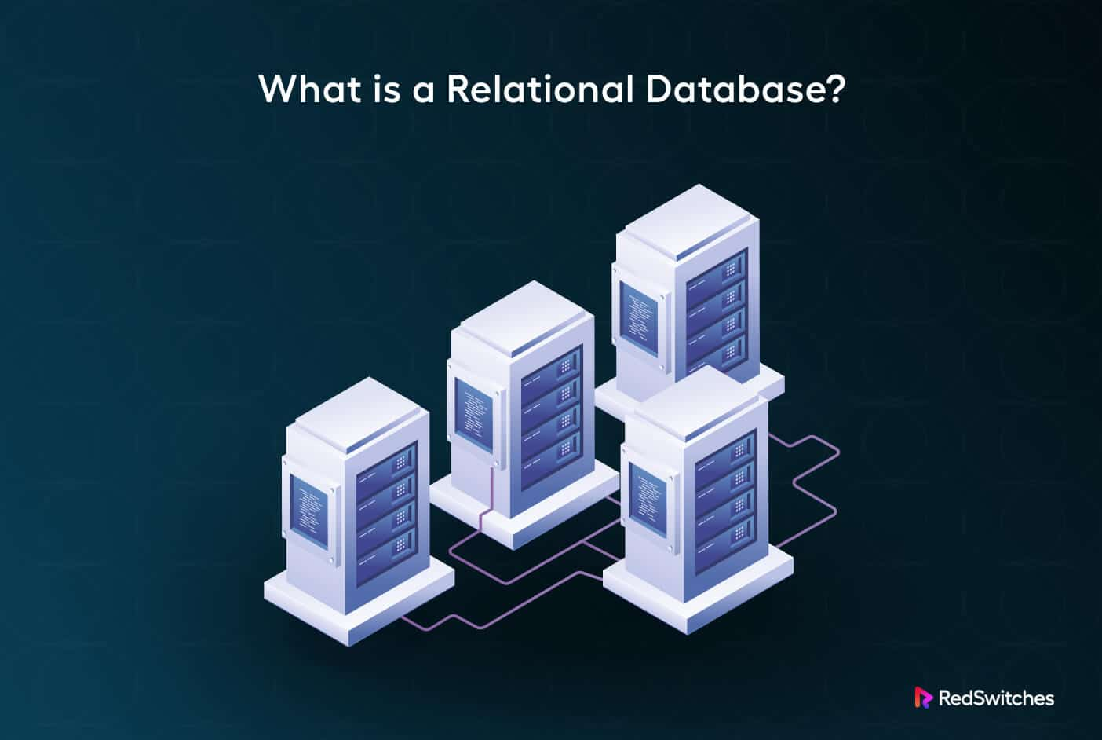

Types of Database
Relational databases.
A relational database organises data in tables, rows and columns and establish relationships between them.
Cloud database
A cloud database is a type of database that runs on a cloud computing platform. It allows users to access, manage, and store data to store data leveraging the flexibility and availabity of cloud recourses.

Slide 4
Strengths and Weaknesses
Relational databases.
Strengths:
It has a good data integrity ensuring the data accuracy through relationships.
Due to it scalability it can handle large amounts of data.
It also has a strong security features.
Weaknesses:
It has complex setup and management. Therefore, it requires careful scheme of design and management
It is also resource intensive requiring high memory and storage requirements
Cloud Database Strengths: It is easy scalability and flexibility which makes it easier to scale up or down depending on the demand
Due to its automated data backups and recovery, it makes it safe in case of any data lose.
It can be accessed anywhere remotely, which makes it ideal for distributed teams.
Weaknesses:
High security risks if not configured securely.
It may have limited control since they are managed by a third-party cloud services providers.

Slide 5
Example of Database Selected.
Health Database
Purpose of the Health Database:
The main purpose of a Health Database, such as for a Doctor's Appointment System, is the storage and management of data about doctors, patients, and appointments. It enhances the efficiency in managing schedules and reduces the chances of human error, hence making it rather easy for the staff to access and make changes to appointments. Here's how this works:
Managing Doctor Schedules: The system keeps a record of each doctor's available time and avoids double booking so that patients can schedule their appointments accordingly.
Tracking Patient Details: Patient information, such as contact details and case histories, is kept on record, which will make access and updating of patient records easy for the staff.
Efficient Appointment Management: Appointments are associated with a patient as well as a doctor and can be quickly scheduled, updated, and canceled.

Slide 6
Example of Database Selected
2. Employment Database
Purpose of the Employment Database:
The key objective of an Employment Database-a Payroll Management System-is to store and manage information regarding employees' salaries, bonuses, deductions, and net pay. It supports the automation of payroll processes so that employees can be paid on time with the right amount.
Employee Record Management: The database maintains a record of each employee's personal and employment details, such as job title, department, and salary history.
Payroll Calculation: It calculates employees' gross salary, applies any bonuses, subtracts deductions (e.g., taxes, insurance), and calculates net pay.
Reporting: It generates reports for HR and finance teams, summarizing payroll data for audits, tax filing, or budget analysis.

Slide 7
Tool and Techniques Used In the Employment Database
Tables:
Employees Table: This table holds information about the employees.
Fields could be: EmployeeID, EmployeeName, Position, Department, DateOfJoining, Salary.
Payroll Table: This table holds payroll information for each employee.
Fields could be: PayrollID, EmployeeID, Salary, Bonuses, Deductions, NetPay.
This structure will enable you to connect payroll information with employee records.
Validation Rules:
EmployeeID Validation: Ensures that no two employees have the same ID.
Salary Validation: Ensures that salaries are within acceptable limits for a particular department or position.
Calculate NetPay: Automatically calculate NetPay from Salary + Bonus-Deductions for accuracy.
Relationships:
One-to-One Relationship: One payroll record per employee per pay period.
For instance, the EmployeeID in the Employees Table would relate to EmployeeID in the Payroll Table for every employee to have a payroll record.
One-to-Many Relationship: An employee could have many payroll records throughout a period of time: a month, for instance.
Forms:
Employee Entry Form: HR can enter details of a new employee to the system.
Fields may be in the form of name, position, and department. The form is simple and assures data homogeneity.
Payroll Entry Form: HR or finance staff enters salary details with or without bonus and deductions to display NetPay automatically.
Queries:
Salary Query:
A query can be designed for retrieving details of employees in a certain department who have salaries over a certain amount.
Example: "List all employees in the Sales Department earning over $60,000."
Payroll Query:
A query may also produce payroll for all employees for a particular month.
Reports:
Monthly Payroll Report:
The payroll report listing all employees and salaries, bonus, deductions, and net pay for the month.
Department Salary Report:
The summary of salary expenditure by each department for any given period.

Slide 8
How the tools/technique used in the employment database improves productivity, accuracy and usability.
Smooth Data Entry and Management: Employee and payroll data, stored in separate, well-structured tables, are easily accessible and may be updated as required. Redundancy is consequently reduced, economizing time and effort. Automated validation rules further quicken the pace of data entry by preventing common mistakes that would require additional time and effort to process with fewer errors.
Error Avoidance and Consistency: Automated checks such as unique EmployeeIDs and valid ranges for salary are in place to maintain data integrity. It uses the relationships between tables to ensure that employee data and payroll records match correctly and cannot be mismatched or duplicated. This reduces errors and gives a correct, accurate payroll calculation and reporting.
The relational design allows for easy access to information since payroll data are related to employee records. Queries allow human resource or finance personnel to generate reports quickly themselves instead of spending a great deal of time sifting through the records. Predefined Reports Predefined reports give standard views of employee and payroll data, streamlining tasks such as producing a monthly payroll.
User-Friendly Interface: The use of forms in capturing information guarantees that even the non-technical staff can provide information without mistakes and easily. Predefined fields and drop-down options on the forms guide users to capture consistent data. The system provides immediate feedback, thus enabling immediate correction of errors.
Reporting: Scalable and Flexible-Running custom queries and making specific reports allow users to obtain whatever data they need for any particular employee, department, or time period more quickly. The flexibility allows for extending the usability whereby staff can then produce reports relevant to their needs without having complex knowledge in databases.
Consistency within the system: Automation of processes, such as the calculation of NetPay and reporting, ensures that results are always the same. This reduces the chances of errors and hence offers reliable information that is up-to-date.

Slide 9
Tool and Techniques Used In the Doctors Database
Tables:
Doctors Table: This table holds information about each doctor.
Fields might include: DoctorID, DoctorName, Specialization, such as Cardiologist, Pediatrician.
Patients Table: This table will hold patient information.
Fields might include: PatientID, PatientName, ContactNumber, Address, DateOfBirth.
Appointments Table: This table links doctors and patients to specific appointment details.
Fields include: AppointmentID, DoctorID, PatientID, Date, Time, and Status, such as Scheduled, Cancelled, Completed.
Appointment Validation: It ensures that two appointments cannot be booked for the same doctor at the same time.
For instance, if Dr. Smith is already booked at 10:00 AM, the system will block any other appointments at that time.
Unique Patient and Doctor IDs: Ensures that no two patients or doctors share the same ID.
This helps maintain data integrity and prevents issues where records could get mixed up.
Relationships:
One-to-Many Relationship:
A doctor can have multiple appointments, but an appointment can only have one doctor and one patient.
The relationship is established through the Appointments Table, in which the DoctorID relates to the DoctorID in the Doctors Table.
Forms:
Appointment Entry Form: This is used by staff for easily and speedily entering information for new appointments.
Example: A receptionist can choose a patient and a doctor from drop-down menus, put in the appointment time, and save the record.
This will make data entry easier on employees who may not understand the intricacies of complex database systems.
Patient Registration Form: This form will help users input and update patient information efficiently.

Slide 10
How the tools/technique used in the doctor database improves productivity, accuracy and usability.
Smooth Data Entry: Forms for appointment entry and patient registration make it easier to enter data quickly, such as selecting doctors and patients from drop-down menus and inputting appointment times. This frees up more time from manually entering data, thus improving overall productivity. The structured forms will, moreover, ensure coherence in the data input, avoiding any mistakes.
Automated Validation: The Appointment Validation module is designed not to allow double booking by automatically blocking the creation of appointments for the same doctor at any given time. Besides saving time, it will not allow any conflict to arise and is hence more accurate. The validation rules ensure that DoctorID and PatientID are unique to avoid duplicate or conflicting records.
Explicit Relationships: One-to-many, between the Doctors table and Appointments table will yield into a many kind of appointment which a single doctor will be attached to and that particular appointment for easy tracking will again be uniquely linked with only that doctor and only that patient to facilitate easy tracking. The staff retrieves and views with ease an appointments history or list of either a particular doctor or that patient.
Easy Data Retrieval and Reporting: The system allows for the quick retrieval of data, such as the availability of doctors or patient history, saving time used by the staff. Reports generated from the database are always current and accurate; hence, the information on which scheduling or decisions are made is reliable, enhancing accuracy.
Consistent and Error-Free Data: The system ensures that unique IDs are assigned to both doctors and patients, which helps in maintaining consistent and error-free records. It prevents any mix-up of doctor or patient data, and the correct information is always used for improving accuracy. It also reduces manual corrections, hence increasing productivity.

Slide 11
Database Structure and Functions
Records: To input individual entries like a patient's details or an employee’s information.
Relationships: This would be used to connect data between tables like linking doctors to patients or employees to departments.
Forms: To Create a user interface for data entry screens for example a form to enter a new patient’s details or a form to enter all employees in a specific department.
Sorts: This would be used to order data and make it more meaningful for analyzation for example sorting patients by appointment date or sorting employees by their department.
Queries: It helps us to retrieve specific information or data for example find all employees in a department or find all patients with the same illness.

Slide 12

Strengths and weaknesses of both database
Health Database strengths: ensures data security and supports quick access to medical history.
Health Database Weaknesses: Requires high security; complex setup.
Employment Database Strengths: Simplifies HR tasks; accurate payroll processing
Employment Database Weaknesses: May require frequent updates; data can become outdated.

